Slide 1

Data Wrangling – Merging, Joining, Reshaping Data
Week 9
Dr. Farshid Keivanian

Slide 2
Week 9 Outline
Welcome to Week 9
Alignment with Unit Outline & Learning Outcomes
Hierarchical Indexing
Hands-On Activity 1
Hands-On Activity 2
Hands-On Activity 3
Hands-On Activity 4
Combining & Merging Datasets
Hands-On Activity 5
Hands-On Activity 6

Slide 3
Week 9 Outline
Hands-On Activity 7
Hands-On Activity 8
Reshaping with Pivot, Melt, Stack & Unstack
Hands-On Activity 9
Hands-On Activity 10
Hands-On Activity 11
Hands-On Activity 12
Research & Discussion Prompts
Role-Play & Problem-Solving (Hands-On Thinking)
A Mini-Project: Student Success Data Wrangling Dashboard

Slide 4
Welcome to Week 9
Last week (Week 8), you learned how to clean messy data — fixing missing values, creating bins, and taking useful samples.
This week, we take the next exciting step: combining different datasets and reshaping them so they’re ready for analysis.

Slide 5
Welcome to Week 9
Think of it like building a puzzle — each table or file is a puzzle piece, and your job is to fit them together to see the full picture. In real life, especially with Australian Bureau of Statistics (ABS) or business datasets, data hardly ever lives in one tidy table. You’ll learn how to:

Slide 6
Welcome to Week 9
Join and merge information from multiple sources (like combining student records with test results).
Reshape data to switch between wide and long formats — a bit like turning a table sideways to get new insights.
Prepare your merged data for visualisation or modelling later on.
By the end of the week, you’ll feel more confident handling real-world, multi-table data, just like professional data analysts do in Australia

Slide 7
Alignment with Unit Outline & Learning Outcomes
How This Week Connects to Your Learning Outcomes
LO1: Build Python fundamentals & use core data science tools (Pandas). LO2: Collect, clean, wrangle, and combine datasets confidently. LO3: Apply these methods to real-world Australian data, such as university or ABS datasets.

Slide 8
Alignment with Unit Outline & Learning Outcomes
Takeaway: By Week 9, you can reshape, merge, and analyze data just like a real data analyst working in Australia’s tech or education sectors.

Slide 9
Hierarchical Indexing
“Hierarchical indexing” means multi-level indexing. Think of it like a filing cabinet — each folder (Region) has subfolders (State). In Pandas, this lets you organise and access data using more than one key — for example, Region + State.

Slide 10
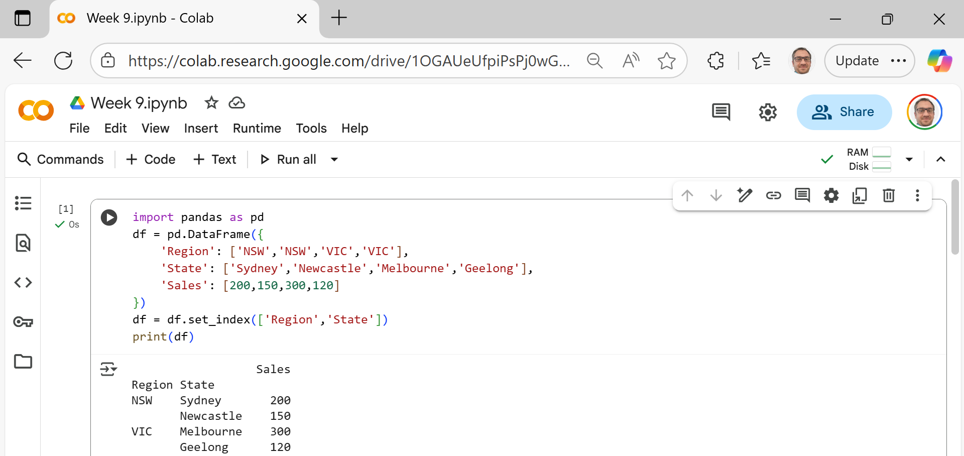
Hierarchical Indexing
We’re bringing in the Pandas library — this is like a powerful spreadsheet tool in Python that helps us work with tables (rows and columns).

Slide 11
Hierarchical Indexing
We’re creating a small table (DataFrame) with three columns:
Region → e.g., NSW, VIC (like states in Australia)
State → specific cities or local areas
Sales → how much was sold in each place

Slide 12
Hierarchical Indexing
It looks like this before indexing:
Region | State | Sales
NSW | Sydney | 200
NSW | Newcastle | 150
VIC | Melbourne | 300
VIC | Geelong | 120

Slide 13
Hierarchical Indexing
Here we tell Pandas:
“Use Region and State as row labels (index) instead of the default 0, 1, 2, 3.”
This creates a multi-level (hierarchical) index — meaning we can now look up data first by Region, then by State inside it.

Slide 14
Hierarchical Indexing
We display the final table. It now shows Region and State stacked together on the left side (the index):

Slide 15
Hierarchical Indexing
In Simple Terms: Imagine a filing cabinet:
The top drawer is Region (NSW, VIC).
Inside each drawer are folders for State (Sydney, Newcastle, etc.).
Inside each folder, you find the Sales numbers.

Slide 16

Hands-On Activity 1
We’ll practise hierarchical indexing with a fun workplace example!
Create a DataFrame with “Department” + “Team” as index

Slide 17
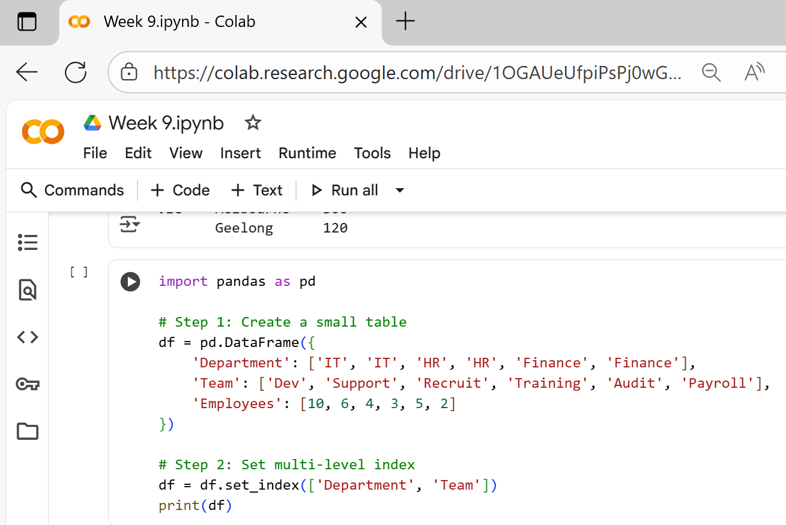
Hands-On Activity 1
We first build a small table (DataFrame) with three columns.
Department – shows which department each team belongs to
Team – the name of the team
Employees – how many people work in that team
This table is stored in a variable called df

Slide 18
Hands-On Activity 1
Set multi-level index
This line sets two columns (Department and Team) as the index of the table.
A multi-level index means the table is now organised in two layers:
Level 1 → Department
Level 2 → Team
So each row can be identified by both Department and Team.
It helps when you want to group, filter, or summarise data later.

Slide 19
Hands-On Activity 1
Print the final table
This shows the table in the output with the new multi-level index format:

Slide 20
Hands-On Activity 1
In summary,
We made a small company table.
We used two columns (Department + Team) as a combined label (multi-index).
This makes the data easier to organise and analyse, for example by department or by team.

Slide 21
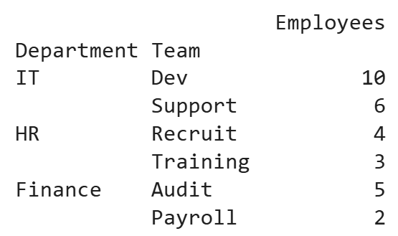
Hands-On Activity 1
Our code creates a small table showing each Department and its Team with the number of employees, then sets Department and Team as a multi-level index — so the output neatly groups teams under each department (like folders within folders).

Slide 22
Hands-On Activity 2
Show all rows from one Department (1-2 min)

Slide 23
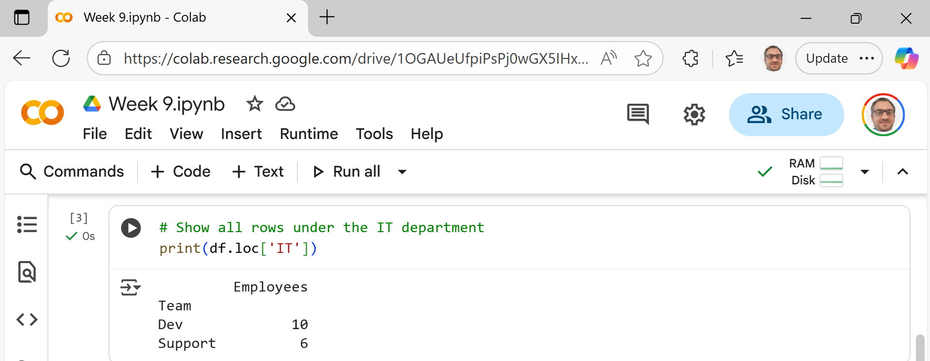
Hands-On Activity 2

Slide 24
Hands-On Activity 3
Add a new column “Budget” with different values in $ thousands then filter rows by Budget > 200

Slide 25
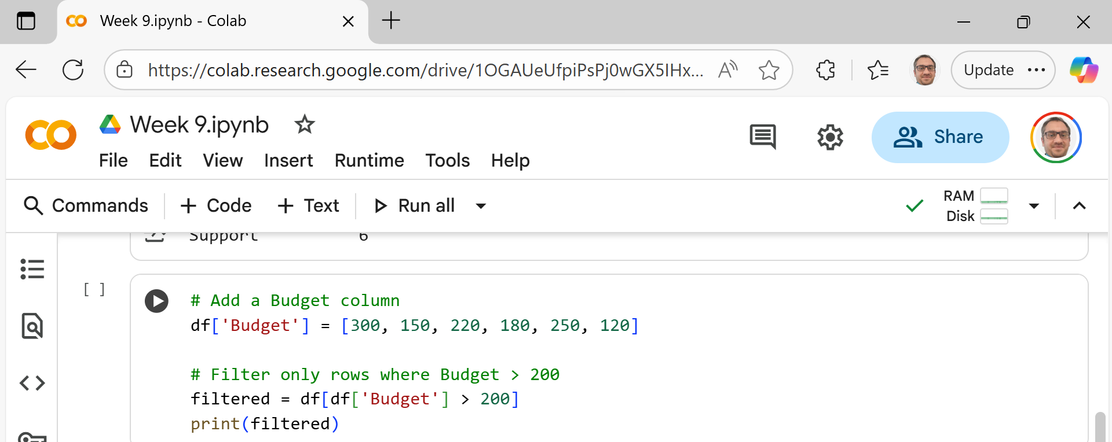
Hands-On Activity 3
We create a new column Budget that shows each team’s budget (in $ thousands).
Then we apply a condition > 200 to keep only the teams whose budget is greater than 200.

Slide 26
Hands-On Activity 4
Reset the index and show as a normal table

Slide 27
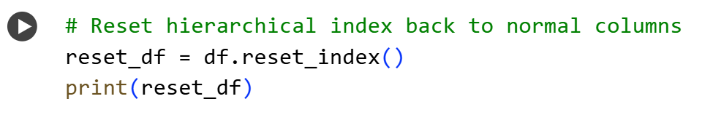
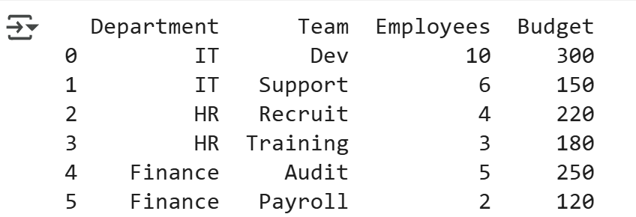
Hands-On Activity 4
reset_index() moves Department and Team out of the index area and back into regular columns.
This is useful when you want to export or join with other tables.

Slide 28
Hands-On Activity 4
Think of hierarchical index like grouping folders by Department → Team.
You can look inside any folder, add more information (like a Budget column), filter by numbers, and finally flatten everything back into one simple table when you’re done.

Slide 29
Combining & Merging Datasets
Merging = like joining two tables together. Think of it like matching puzzle pieces — you connect rows that share something in common (like an ID).

Slide 30
Combining & Merging Datasets
Type | What It Does
Inner Join | Keeps only rows that match in both tables.
Left Join | Keeps all rows from the left table; fills missing from the right with NaN.
Right Join | Keeps all rows from the right table; fills missing from the left with NaN.
Outer Join | Keeps everything from both; fills missing with NaN.

Slide 31
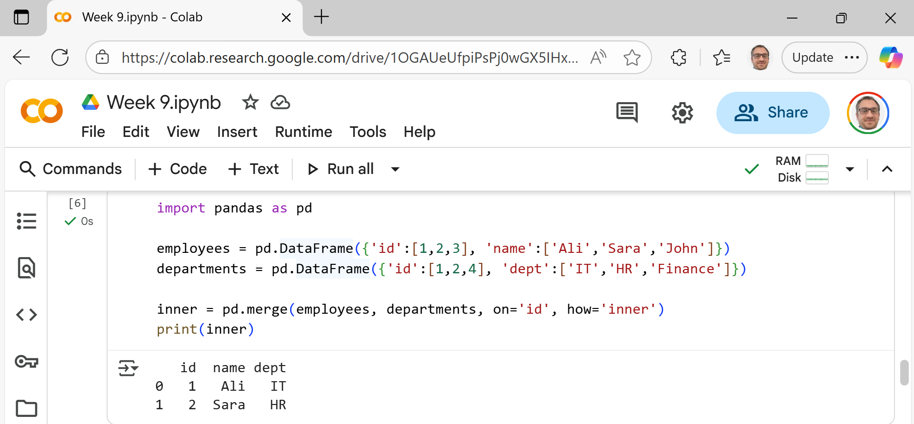
We make two tables: one for employees, one for departments.
Both have a column id that connects them.
how='inner' means keep only IDs that appear in both.

Slide 32
We start by importing the Pandas library, which helps us work with tables (DataFrames) in Python — like Excel sheets but smarter.

Slide 33
This creates our first table — a list of employees. It has two columns:
id → each person’s unique number
name → their name
Think of it as a small “Employee List.”

Slide 34
This creates the second table, showing departments. It also has an id column — which will help us connect employees to departments — and a dept column for the department name.
This is our “Department List.”

Slide 35
This is the main action — the merge! We tell Pandas to:
Join both tables where the “id” matches
Use an Inner Join, which means: Keep only rows that appear in both tables
It’s like finding names that exist in both attendance sheets.

Slide 36
Show the final result.

Slide 37
Only Ali (id=1) and Sara (id=2) appear in both tables.
John (id=3) doesn’t have a matching department.
Finance (id=4) doesn’t have a matching employee.

Slide 38
So only the matching pairs stay! It’s just like joining puzzle pieces that actually fit together — any unmatched ones are left aside.

Slide 39
Hands-On Activity 5
Merge Students and Grades (Inner Join)
Create two small tables (DataFrames):
One called students with columns id and name.
One called grades with columns id and grade.
Use the pd.merge() function to combine the two tables based on the id column — this is how we connect students to their grades.
Set how='inner' → this means: Keep only the students whose IDs appear in both tables. (If a student has no grade or a grade has no matching student, they will be left out.)
Print the merged result to see which students have grades.

Slide 40
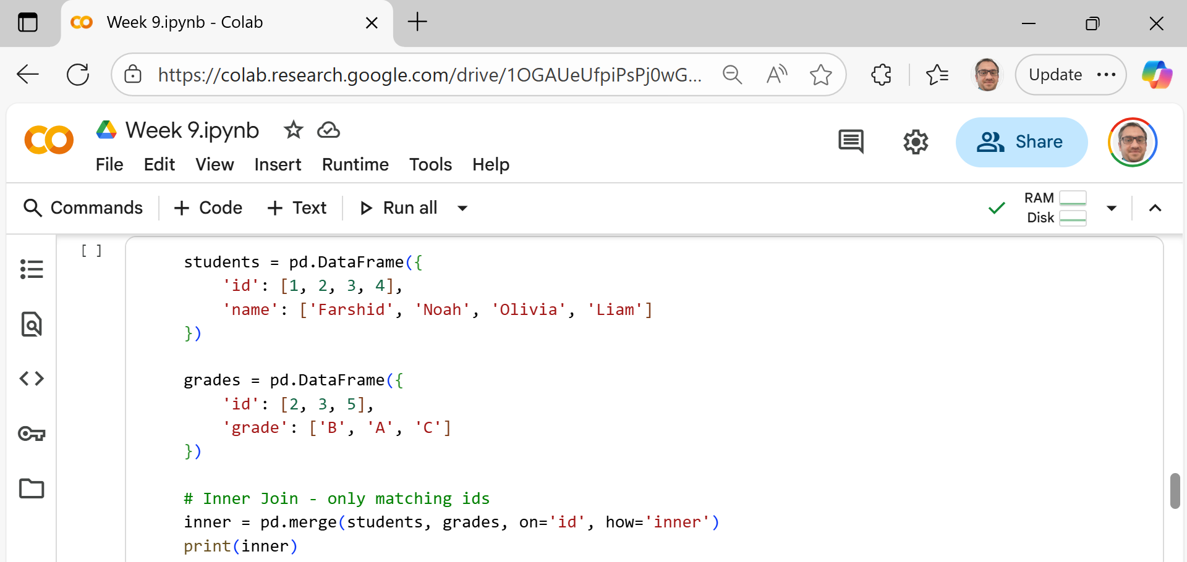
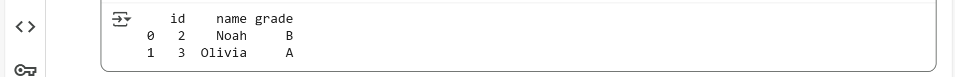
Hands-On Activity 5
We connect students and grades where their id matches.
Students without grades or grades without students are ignored.

Slide 41
Hands-On Activity 5
Step 1: Create the first table — students
This creates a table (called a DataFrame) with:

Slide 42
Hands-On Activity 5
Step 2: Create the second table — grades
This creates another DataFrame
It lists grades for some students, but notice:
Only id 2 and 3 exist in both tables.
id 5 appears only in grades, not in students.

Slide 43
Hands-On Activity 5
Step 3: Merge the two tables (Inner Join)
What this does:
pd.merge() combines the two tables together.
on='id' means they should be matched by the id column.
how='inner' means only keep rows where the id exists in both tables.

Slide 44
Hands-On Activity 5
Display the result

Slide 45
Hands-On Activity 5
Only matching IDs (2 and 3) are included.
Students Noah and Olivia appear in both lists, so they are shown with their grades.
Farshid and Liam (IDs 1 and 4) are missing because they don’t have grades listed.
ID 5 (grade C) is also missing because that student doesn’t exist in the students list.

Slide 46
Hands-On Activity 5
Summary:
Concept | Meaning
Inner Join | Keeps only the matching rows from both tables
on='id' | Uses the id column to find matches
Result | Only shows students who have grades available

Slide 47
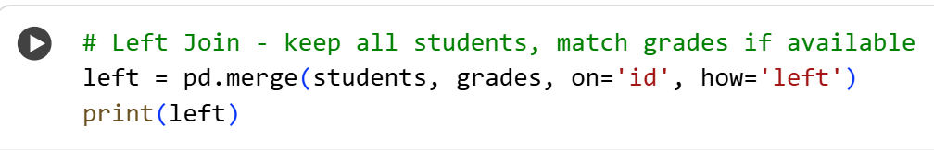
Hands-On Activity 6
Repeat with Left Join
Run the code below in Google Colab:
2. Observe the output table that appears.
3. Explain in your own words:
What does the how='left' option mean?
Which table’s data is fully kept (students or grades)?
What happens when a student does not have a grade?

Slide 48
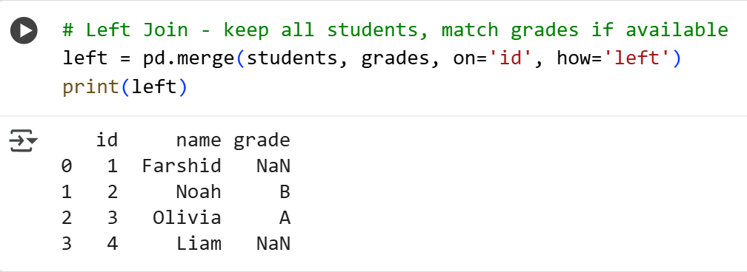
Hands-On Activity 6
pd.merge → joins (combines) two tables.
students, grades → the two tables being joined.
on='id' → tells Python to match rows using the id column.
how='left' → means keep all rows from the left table (students) even if no match is found in the grades table.

Slide 49
Hands-On Activity 6
print(left) → shows the combined result.

Slide 50
Hands-On Activity 6
What does the how='left' option mean?
➜ It means keep all students from the left table, even if they don’t have grades.
2. Which table’s data is fully kept (students or grades)?
➜ The students table is fully kept.

Slide 51
Hands-On Activity 6
What happens when a student does not have a grade?
➜ The grade column shows NaN, which means “no data” or “missing value.”

Slide 52
Hands-On Activity 6
Every student appears in the result (Farshid, Noah, Olivia, Liam).
Noah and Olivia have grades because they matched with IDs in the grades table.
Farshid and Liam have NaN because there were no matching IDs in the grades table.
So, a Left Join helps you keep all data from the main list (students) while showing whatever information is available from the second list (grades).

Slide 53
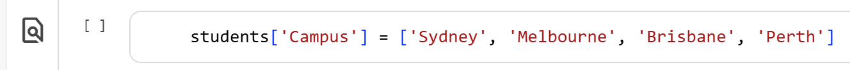
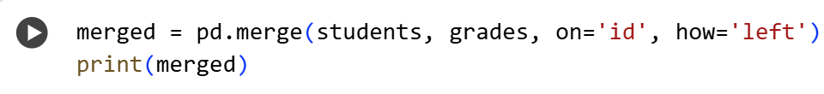
Hands-On Activity 7
Add a “Campus” Column and Merge Again
Add a new column called "Campus" to the students table using this code: (1-2 min)
Merge the updated students table with the grades table again: (1-2 min)

Slide 54
Hands-On Activity 7
Run the code in Google Colab and observe the new table.
Answer these questions in your own words:
What new information did we add to the students table?
What does the merge still use to match rows?
What happens to the “grade” column for students without a match?
How does the final table look different from the previous one?

Slide 55

Hands-On Activity 7
What new information did we add to the students table?
We added a new column called “Campus” that shows where each student studies — for example, Sydney, Melbourne, Brisbane, or Perth.

Slide 56
Hands-On Activity 7
What does the merge still use to match rows?
The merge still uses the “id” column to connect students with their grades.

Slide 57
Hands-On Activity 7
What happens to the “grade” column for students without a match?
If a student doesn’t have a grade, the “grade” column shows NaN, which means “no data” or “not available.”

Slide 58
Hands-On Activity 7
How does the final table look different from the previous one?
The final table now includes an extra “Campus” column, so each student shows both their campus and their grade (if available). Farshid and Liam still have NaN in the grade column, but now we also know their campus.

Slide 59
Hands-On Activity 7
In summary, we made the students table more detailed by adding campus info, and the merge still joins by ID while keeping all students listed.

Slide 60
Hands-On Activity 8
What If Column Names Differ?
Task Instructions (Step-by-Step in Simple Terms):
Create a new table called grades2
This table should have two columns:
student_id → like the ID card number
grade → the letter grade (A, B, or C)
Notice that this new table doesn’t use the same column name as the students table — it uses student_id instead of id. This difference is important because Pandas needs to know which columns to match.

Slide 61
Hands-On Activity 8
Merge the two tables (students and grades2) using pd.merge().
Use the parameter left_on='id' to tell Pandas: “The left table uses the column called id.”
Use the parameter right_on='student_id' to tell Pandas: “The right table uses the column called student_id.”
Use how='left' to keep all students, even if some don’t have a matching grade.
Print the merged result and check:
Which students got matched correctly?
Which students have NaN (missing grade)?

Slide 62
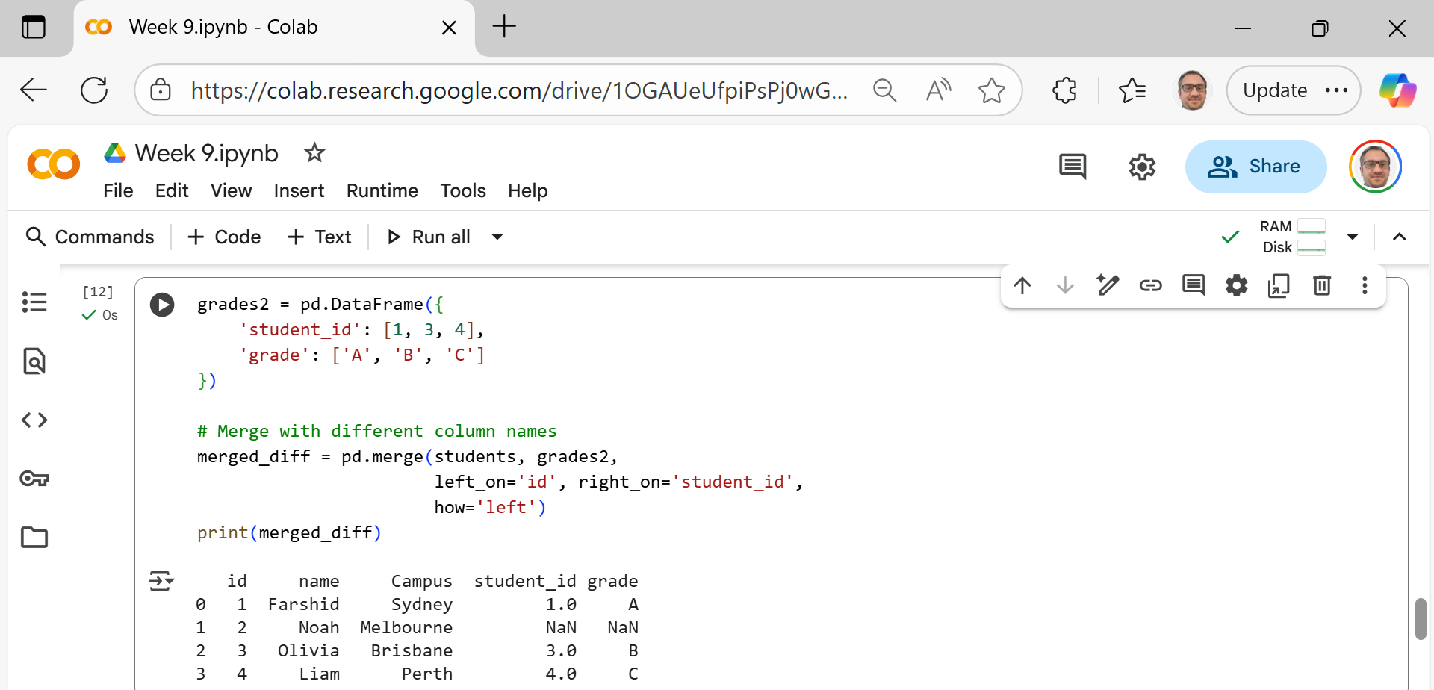
Hands-On Activity 8
We create a new table (DataFrame) named grades2. It has two columns:
student_id → the student’s ID number
grade → the student’s letter grade
Notice that the column name is student_id, not id — this is different from the earlier students table.

Slide 63
Hands-On Activity 8
This line combines (merges) the students table with grades2.
left_on='id' → The column name used in the students table.
right_on='student_id' → The column name used in the grades2 table.
how='left' → Keep all students from the left table (students), even if they don’t have a grade.
In short: we’re saying “Match students and grades using the ID columns, even though the column names are different.”

Slide 64
Hands-On Activity 8
This prints out the new merged table so we can see the combined results.

Slide 65
Hands-On Activity 8
The merge successfully matched students and grades using id (left table) and student_id (right table).
Farshid, Olivia, and Liam have matching grades (A, B, and C).

Slide 66
Hands-On Activity 8
Noah does not appear in the grades2 table, so his grade is shown as NaN (which means no data or missing).
Both column names (id and student_id) appear in the final table to remind us where each came from.

Slide 67
Hands-On Activity 8
We just told Python:
“Hey Pandas, my two tables have different column names for the same thing — please match them anyway using these names.”

Slide 68
Reshaping with Pivot, Melt, Stack & Unstack
Reshaping means changing the shape of your data table — like rotating or unfolding it.
Function | What It Does | Simple Meaning
pivot() | Turns rows → columns | “Flip data sideways”
pivot_table() | Like pivot(), but can calculate sums or averages | “Group + summarize”
melt() | Turns wide → long | “Unfold wide data into tall format”
stack() / unstack() | Moves columns ↔ rows | “Fold or unfold multi-level data”

Slide 69
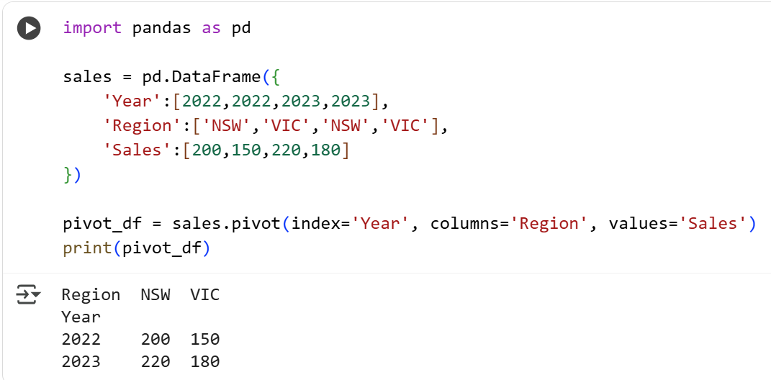
Reshaping with Pivot, Melt, Stack & Unstack
Example: Pivot Sales by Region
We build a sales table with columns for year, region, and sales.
pivot() moves regions into columns and keeps years as rows.
Each cell now shows that region’s sales for that year.

Slide 70
Reshaping with Pivot, Melt, Stack & Unstack
Example: Pivot Sales by Region
Import Pandas:
This line loads the pandas library (a tool that helps us work with tables of data) and shortens its name to pd so we can use it easily later.

Slide 71
Reshaping with Pivot, Melt, Stack & Unstack
Example: Pivot Sales by Region
Create a small sales table:
This creates a DataFrame (a small table) with 3 columns:
Year → shows which year the sales belong to
Region → the location (NSW or VIC)
Sales → the sales amount
So, this table tells us how much each region sold in each year.

Slide 72
Reshaping with Pivot, Melt, Stack & Unstack
Example: Pivot Sales by Region
Create a pivot table
This line reshapes the table so it’s easier to compare sales by year and region.
index='Year' → each row will represent a year
columns='Region' → each column will represent a region (NSW or VIC)
values='Sales' → the numbers in the table will show the sales amounts

Slide 73
Reshaping with Pivot, Melt, Stack & Unstack
Example: Pivot Sales by Region
The pivot table shows sales for each region in each year.
The rows represent years (2022 and 2023).
The columns represent regions (NSW and VIC).
The numbers are the sales values from the original table.
So, we can quickly see that:
In 2022, NSW sold 200 and VIC sold 150.
In 2023, NSW sold 220 and VIC sold 180.

Slide 74
Reshaping with Pivot, Melt, Stack & Unstack
Summary
Step | What It Does
Create table | Builds a dataset of Year, Region, and Sales
Pivot | Rearranges data for easier comparison
Output | Shows sales per year and per region

Slide 75
Hands-On Activity 9
Create a table of students with marks in 3 subjects, then pivot to show each subject as a column.

Slide 76
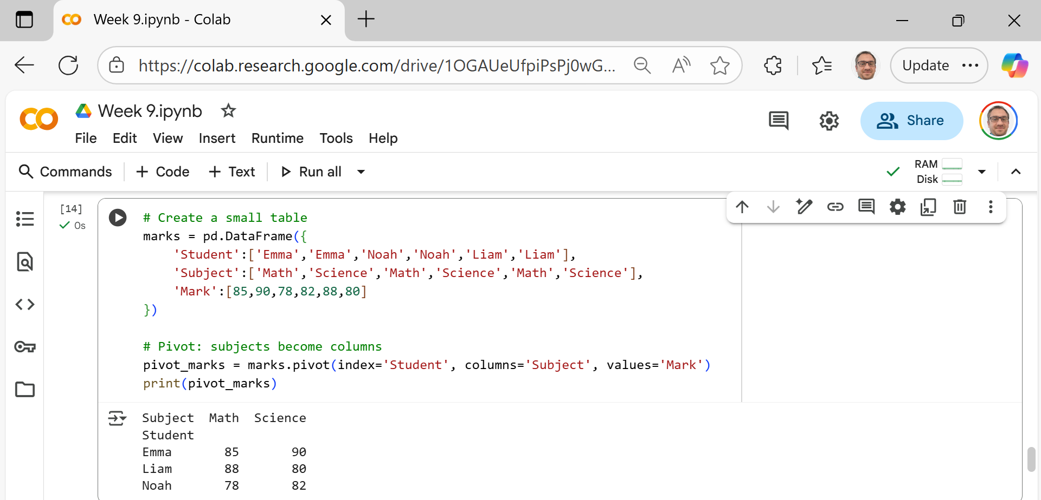
Hands-On Activity 9
Create a small table (DataFrame): This creates a table (DataFrame) with three columns. It shows each student’s name, the subject, and their mark.

Slide 77
Hands-On Activity 9
Pivot the table: This line reshapes the table to make it easier to compare marks.
index='Student' → each row represents a student.
columns='Subject' → each column becomes a subject (Math, Science).
values='Mark' → the numbers shown are the marks.
So instead of having subjects listed in rows, we now see them as columns.

Slide 78
Hands-On Activity 9
Print the new table. This displays the new, cleaner format:

Slide 79
Hands-On Activity 9
Each student now appears once in the table.
Their Math and Science marks are shown side by side.
It’s now much easier to read and compare students’ marks.

Slide 80
Hands-On Activity 9
Summary
Step | What it Does
Create table | Makes a list of students, subjects, and marks
Pivot | Turns subjects into columns for easier comparison
Output | Shows each student’s marks for each subject clearly

Slide 81
Hands-On Activity 10
Change wide data (months as columns) into a long list of rows.

Slide 82
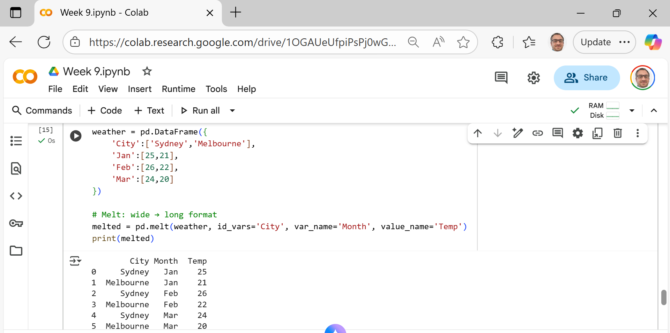
Hands-On Activity 10
Create the original data: This creates a table showing average monthly temperatures for two cities.
Each column (Jan, Feb, Mar) represents a month, so the table is in wide format — multiple columns for different months.

Slide 83
Hands-On Activity 10
Melt the table (wide → long format)
This reshapes the data:
id_vars='City' → keep the City column as it is.
var_name='Month' → create a new column named Month (taken from old column names: Jan, Feb, Mar).

Slide 84
Hands-On Activity 10
Melt the table (wide → long format)
value_name='Temp' → create a new column named Temp (taken from the numbers under each month).
So instead of 3 month columns, we now have one column listing all months.

Slide 85
Hands-On Activity 10
Print the new (long) table
The table is now longer (more rows) but narrower (fewer columns).
Each row now shows: City → Month → Temperature.
This format is often easier for plotting graphs or data analysis.

Slide 86
Hands-On Activity 10
Summary
Step | What It Does
Create table | Makes monthly temperature data for each city
Melt | Converts months from columns into one “Month” column
Result | Easier to read and analyse in long format

Slide 87
Hands-On Activity 11
Convert a wide table of Australian states into long format using stack(), then back with unstack().

Slide 88
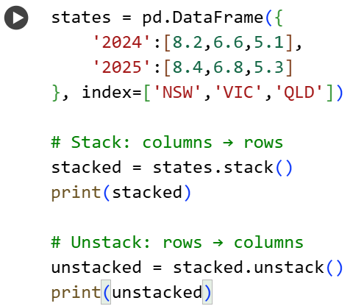
Hands-On Activity 11
Step 1: Create a small table: This makes a DataFrame (table) showing, for example, the growth rates or values for three Australian states across two years.

Slide 89
Hands-On Activity 11
Here:
Each row = one state
Each column = one year
This is a wide format table — years spread across columns.

Slide 90
Hands-On Activity 11
Step 2: Stack — convert columns → rows
The stack() function moves columns down into rows, creating a long format view. Now we get
State | Year | Value
NSW | 2024 | 8.2
NSW | 2025 | 8.4
VIC | 2024 | 6.6
VIC | 2025 | 6.8
QLD | 2024 | 5.1
QLD | 2025 | 5.3

Slide 91
Hands-On Activity 11
In pandas output, we’ll see it displayed like this (multi-level index):
NSW 2024 8.2
2025 8.4
VIC 2024 6.6
2025 6.8
QLD 2024 5.1
2025 5.3
dtype: float64
In simple terms—stack() turns columns into rows (wide → long).

Slide 92
Hands-On Activity 11
Unstack — convert rows → columns
The unstack() function does the opposite — It turns rows back into columns, restoring the original wide format.
Output again becomes:
In simple terms — unstack() turns rows back into columns (long → wide).
State | 2024 | 2025
NSW | 8.2 | 8.4
VIC | 6.6 | 6.8
QLD | 5.1 | 5.3

Slide 93
Hands-On Activity 11
Result Summary
Function | Action | Format Change
stack() | Moves columns into rows | Wide → Long
unstack() | Moves rows back into columns | Long → Wide
In simple classroom terms
stack() = “fold” columns down
unstack() = “unfold” them back up

Slide 94
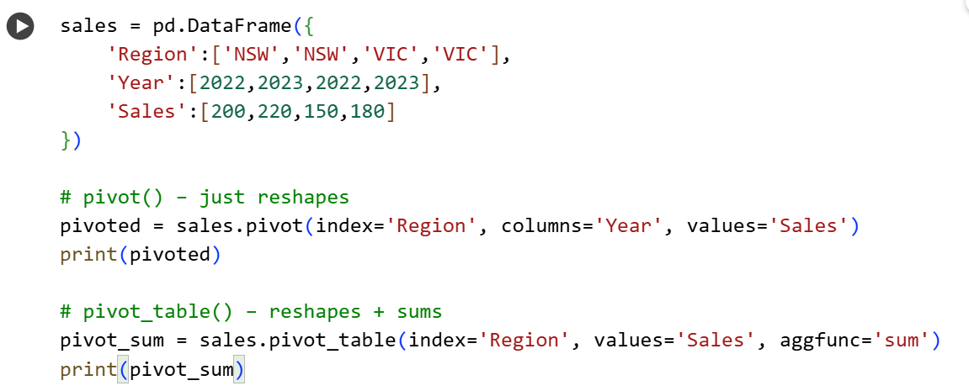
Hands-On Activity 12
Compare pivot() vs pivot_table()
See how pivot_table() can also summarize data.

Slide 95
Hands-On Activity 12
Step 1: Create a simple sales table: This makes a small DataFrame showing sales by region and year: It lists each region’s sales for two years.

Slide 96
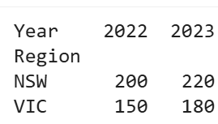
Hands-On Activity 12
Step 2: Use pivot() — reshapes data:
The pivot() function reshapes the table so:
Each row represents a region (Region → index)
Each column represents a year (Year → columns)
The cell values show the sales (Sales → values)

Slide 97
Hands-On Activity 12
pivot() only changes the shape — it doesn’t do any calculations.

Slide 98
Hands-On Activity 12
It adds together sales across years for each region.
Step 3: Use pivot_table() — reshapes + calculates
The pivot_table() function can reshape and also perform calculations (like sum, mean, etc.)
Here:
index='Region' → group by region
values='Sales' → use the Sales column
aggfunc='sum' → sum up sales for each region
Output:
Region | Sales
NSW | 420
VIC | 330

Slide 99
Hands-On Activity 12
Simple Comparison
Function | What it does | Example result
pivot() | Just reshapes data | Year columns (2022, 2023) shown separately
pivot_table() | Reshapes and performs a calculation (like sum or average) | Totals or averages by group

Slide 100
Hands-On Activity 12
pivot() → “Rearrange the table for easier viewing.”
pivot_table() → “Rearrange and calculate something at the same time.”

Slide 101
Research & Discussion Prompts
Q1: Why might an inner join drop important rows?
Because it only keeps matching records — any non-matching rows are lost.
Q2: Should we always use an outer join to keep everything?
Not always — it keeps all rows but adds NaN (missing values) you’ll need to clean later.

Slide 102
Research & Discussion Prompts
Q3: Which reshaping method works best for survey data with repeated columns?
Melt — it turns many similar columns into one long, tidy list that’s easy to analyze.
Key Idea: Choose the right join or reshape for your data goal — no one method fits all!

Slide 103
Role-Play & Problem-Solving (Hands-On Thinking)
Scenario 1 – University Data: You’re an analyst at an Australian university.
Student info → one file
Marks → another
Attendance → third
Debate in pairs: Would you use a left join (keep all students) or an inner join (only those with marks + attendance)? Discuss: Which join gives the best report for student success?

Slide 104
Role-Play & Problem-Solving (Hands-On Thinking)
Scenario 2 – ABS Census Data: The Australian Bureau of Statistics (ABS) provides data with one column per year. How would you make it easier to plot or summarize?
Answer: Use melt() → converts wide yearly columns into long, tidy format (City + Year + Value).
Outcome: Learn how to choose the right join or reshape for real-life Australian datasets.

Slide 105
A Mini-Project: Student Success Data Wrangling Dashboard
Practical Scenario
Students act as junior data analysts for a university. They must combine student demographic data, subject results, and attendance-style information to prepare a clean report for academic support planning.
https://colab.research.google.com/drive/1uRbFkddHfPOp7hGPyVdLRBYL0w0aUsvU?usp=sharing

Slide 106
A Mini-Project: Student Success Data Wrangling Dashboard
Use the UCI Student Performance Dataset, which includes student demographic, social, school-related, and grade data for Mathematics and Portuguese subjects. The repository provides two subject datasets, making it suitable for merge and reshape practice.
https://colab.research.google.com/drive/1uRbFkddHfPOp7hGPyVdLRBYL0w0aUsvU?usp=sharing

Slide 107
A Mini-Project: Student Success Data Wrangling Dashboard
Learning Objectives
By the end, students can:
Create and use hierarchical indexes.
Merge datasets using inner, left, outer joins.
Handle different key column names.
Reshape data using pivot, pivot_table, melt, stack, and unstack.
Prepare a tidy dataset for analysis or visualisation.

Slide 108
A Mini-Project: Student Success Data Wrangling Dashboard
Mini-Project Tasks
Task 1: Load the Dataset
import pandas as pd
base_url = "https://raw.githubusercontent.com/FarshidKeivanian/Sessions_Python/main/"
students = pd.read_csv(base_url + "students.csv")
grades = pd.read_csv(base_url + "grades.csv")
subjects = pd.read_csv(base_url + "subjects.csv")
attendance = pd.read_csv(base_url + "attendance_wide.csv")
students.head()
https://colab.research.google.com/drive/1uRbFkddHfPOp7hGPyVdLRBYL0w0aUsvU?usp=sharing

Slide 109
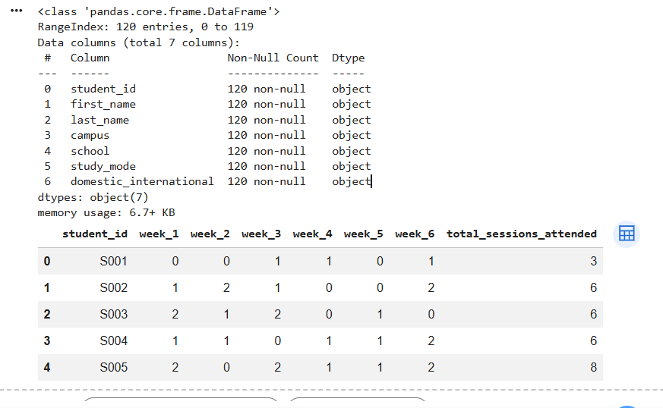
A Mini-Project: Student Success Data Wrangling Dashboard
Task 2: Inspect the Datasets
students.shape
students.columns
students.info()
grades.head()
subjects.head()
attendance.head()
https://colab.research.google.com/drive/1uRbFkddHfPOp7hGPyVdLRBYL0w0aUsvU?usp=sharing

Slide 110
A Mini-Project: Student Success Data Wrangling Dashboard
Task 3: Understand the Student ID
The synthetic dataset already includes a unique student ID, so we do not need to create one.
students[["student_id", "first_name", "last_name", "campus", "school"]].head()
student_id is the common key that connects the students, grades, and attendance tables.
https://colab.research.google.com/drive/1uRbFkddHfPOp7hGPyVdLRBYL0w0aUsvU?usp=sharing

Slide 111
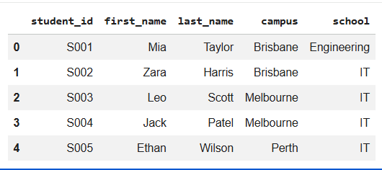
A Mini-Project: Student Success Data Wrangling Dashboard
https://colab.research.google.com/drive/1uRbFkddHfPOp7hGPyVdLRBYL0w0aUsvU?usp=sharing

Slide 112
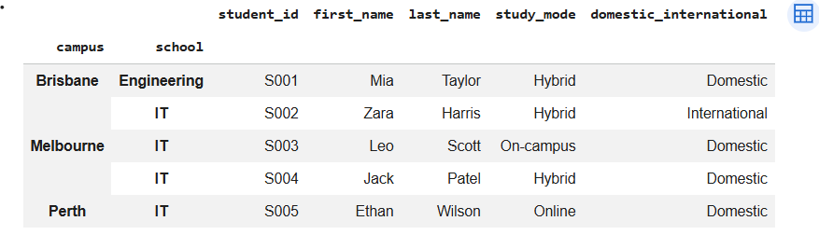
A Mini-Project: Student Success Data Wrangling Dashboard
Task 4: Hierarchical Indexing
Create a multi-level index using campus and school.
students_indexed = students.set_index(["campus", "school"])
students_indexed.head()
https://colab.research.google.com/drive/1uRbFkddHfPOp7hGPyVdLRBYL0w0aUsvU?usp=sharing

Slide 113
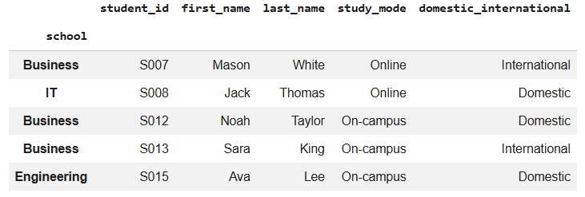
A Mini-Project: Student Success Data Wrangling Dashboard
Show all students from one campus:
students_indexed.loc["Sydney"].head()
https://colab.research.google.com/drive/1uRbFkddHfPOp7hGPyVdLRBYL0w0aUsvU?usp=sharing

Slide 114
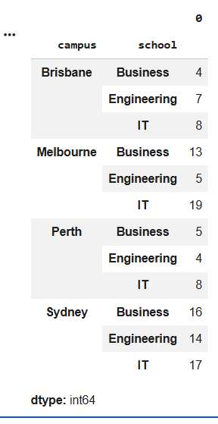
A Mini-Project: Student Success Data Wrangling Dashboard
Count students by campus and school:
students_indexed.groupby(level=["campus", "school"]).size()
https://colab.research.google.com/drive/1uRbFkddHfPOp7hGPyVdLRBYL0w0aUsvU?usp=sharing

Slide 115
A Mini-Project: Student Success Data Wrangling Dashboard
Student reflection:
What does the first index level represent? What does the second index level represent?
https://colab.research.google.com/drive/1uRbFkddHfPOp7hGPyVdLRBYL0w0aUsvU?usp=sharing

Slide 116
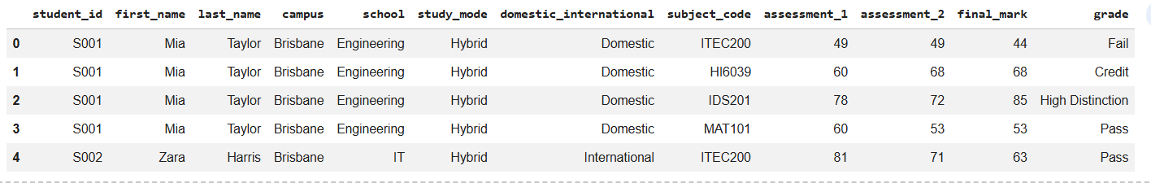
A Mini-Project: Student Success Data Wrangling Dashboard
Task 4: Inner Join Example
Merge student information with grades.
inner_result = pd.merge(
students,
grades,
on="student_id",
how="inner"
)
inner_result.head()
https://colab.research.google.com/drive/1uRbFkddHfPOp7hGPyVdLRBYL0w0aUsvU?usp=sharing

Slide 117
A Mini-Project: Student Success Data Wrangling Dashboard
Task 5: Left Join Example
Keep all students, even if some students do not have matching grade records.
left_result = pd.merge(
students,
grades,
on="student_id",
how="left"
)
left_result.head()

Slide 118
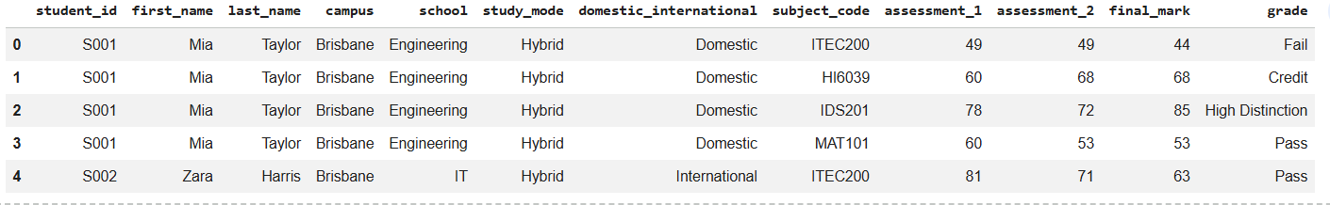
A Mini-Project: Student Success Data Wrangling Dashboard

Slide 119
A Mini-Project: Student Success Data Wrangling Dashboard
Task 6: Outer Join Example
Use an outer join to keep all records from both tables.
outer_result = pd.merge(
students,
grades,
on="student_id",
how="outer",
indicator=True
)
outer_result.head()

Slide 120
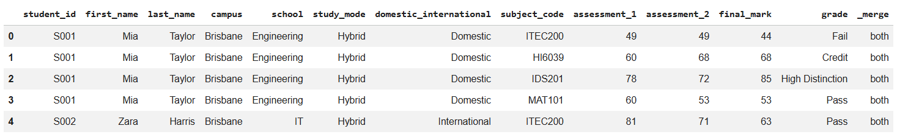
A Mini-Project: Student Success Data Wrangling Dashboard
Discussion:
An outer join is useful for finding records that exist in one table but not the other.

Slide 121
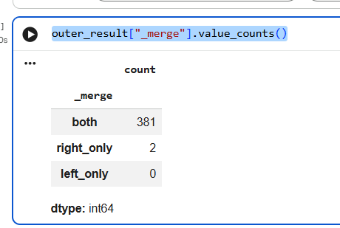
A Mini-Project: Student Success Data Wrangling Dashboard
Check where each row came from:
outer_result["_merge"].value_counts()

Slide 122
A Mini-Project: Student Success Data Wrangling Dashboard
Task 7: Merge with Different Column Names
Rename the key column in the grades table.
grades2 = grades.rename(columns={"student_id": "grade_student_id"})
merged_diff_keys = pd.merge(
students,
grades2,
left_on="student_id",
right_on="grade_student_id",
how="left"
)
merged_diff_keys.head()

Slide 123
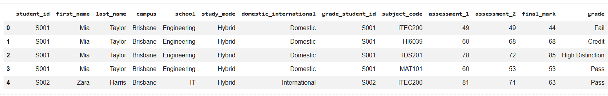
A Mini-Project: Student Success Data Wrangling Dashboard

Slide 124
A Mini-Project: Student Success Data Wrangling Dashboard
Task 8: Merge Three Datasets
Merge students, grades, and subjects.
student_results = pd.merge(
students,
grades,
on="student_id",
how="left"
)
student_results = pd.merge(
student_results,
subjects,
on="subject_code",
how="left"
)
student_results.head()
This code joins the students table with the grades table.
students → contains student details such as name, campus, and school.
grades → contains subject marks and grades.

Slide 125
A Mini-Project: Student Success Data Wrangling Dashboard
Task 8: Merge Three Datasets
Merge students, grades, and subjects.
student_results = pd.merge(
students,
grades,
on="student_id",
how="left"
)
student_results = pd.merge(
student_results,
subjects,
on="subject_code",
how="left"
)
student_results.head()
on="student_id"
This tells Python:
“Use the student_id column to match rows between the two tables.”

Slide 126
A Mini-Project: Student Success Data Wrangling Dashboard
Task 8: Merge Three Datasets
Merge students, grades, and subjects.
student_results = pd.merge(
students,
grades,
on="student_id",
how="left"
)
student_results = pd.merge(
student_results,
subjects,
on="subject_code",
how="left"
)
student_results.head()
So if a student has the same student_id in both tables, their information gets combined together.

Slide 127
A Mini-Project: Student Success Data Wrangling Dashboard
Task 8: Merge Three Datasets
Merge students, grades, and subjects.
student_results = pd.merge(
students,
grades,
on="student_id",
how="left"
)
student_results = pd.merge(
student_results,
subjects,
on="subject_code",
how="left"
)
student_results.head()
how="left“
This means:
“Keep ALL students from the left table (students), even if some students do not have grades.”
If a student has no grade record, Python will show NaN (missing value).

Slide 128
A Mini-Project: Student Success Data Wrangling Dashboard
Second Merge
Now we take the new merged table (student_results) and connect it with the subjects table.
student_results already has student details + grades.
subjects contains subject names and faculty information.
on="subject_code"
This tells Python:
“Match the rows using the subject_code column.”
student_results = pd.merge(
students,
grades,
on="student_id",
how="left"
)
student_results = pd.merge(
student_results,
subjects,
on="subject_code",
how="left"
)
student_results.head()

Slide 129
A Mini-Project: Student Success Data Wrangling Dashboard
Second Merge
What happens after this merge?
The final table now contains:
Student details
Subject codes
Subject names
Final marks
Grade information
all together in one big table.
student_results = pd.merge(
students,
grades,
on="student_id",
how="left"
)
student_results = pd.merge(
student_results,
subjects,
on="subject_code",
how="left"
)
student_results.head()

Slide 130
A Mini-Project: Student Success Data Wrangling Dashboard
Second Merge
student_results.head()
This displays the first 5 rows of the final merged table so we can check the result.
student_results = pd.merge(
students,
grades,
on="student_id",
how="left"
)
student_results = pd.merge(
student_results,
subjects,
on="subject_code",
how="left"
)
student_results.head()

Slide 131
A Mini-Project: Student Success Data Wrangling Dashboard
Second Merge
Step 1: Join students with grades using student_id.
Step 2: Join the result with subjects using subject_code.
Step 3: Display the final combined table.
student_results = pd.merge(
students,
grades,
on="student_id",
how="left"
)
student_results = pd.merge(
student_results,
subjects,
on="subject_code",
how="left"
)
student_results.head()

Slide 132
A Mini-Project: Student Success Data Wrangling Dashboard
Real-Life Analogy
Imagine:
One Excel file has student information.
Another Excel file has marks.
Another Excel file has subject names.
merge() combines them into one complete report.

Slide 133
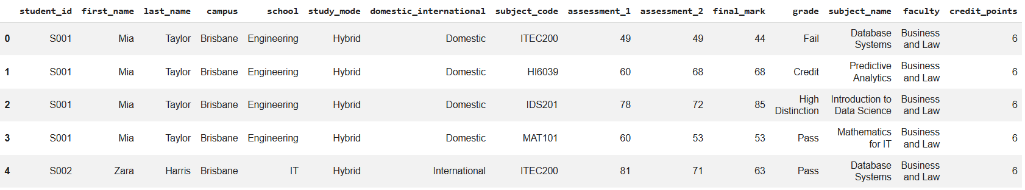
A Mini-Project: Student Success Data Wrangling Dashboard
This creates a richer table with student details, grades, and subject names.

Slide 134
A Mini-Project: Student Success Data Wrangling Dashboard
Task 9: Pivot Grades by Subject
Create a wide table where each subject becomes a column.
grade_pivot = student_results.pivot_table(
index="student_id",
columns="subject_code",
values="final_mark",
aggfunc="mean"
)
grade_pivot.head()

Slide 135
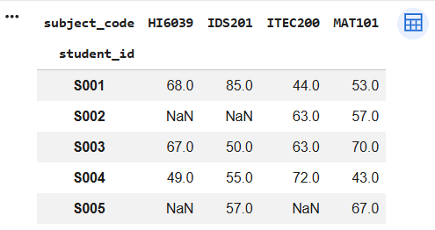
A Mini-Project: Student Success Data Wrangling Dashboard

Slide 136
A Mini-Project: Student Success Data Wrangling Dashboard
Task 10: Melt Wide Data Back to Long Format
Convert the pivot table back into long format.
grade_wide = grade_pivot.reset_index()
grade_long = grade_wide.melt(
id_vars="student_id",
var_name="subject_code",
value_name="final_mark"
)
grade_long.head()

Slide 137
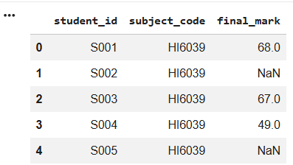
A Mini-Project: Student Success Data Wrangling Dashboard

Slide 138
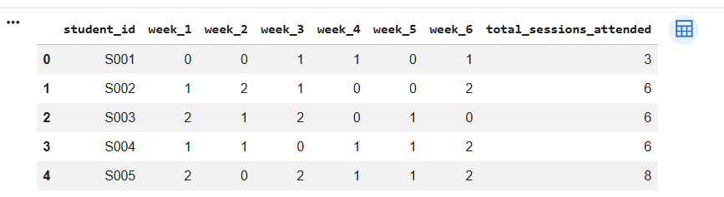
A Mini-Project: Student Success Data Wrangling Dashboard
Task 11: Melt Attendance Data
The attendance table is already in wide format.
attendance.head()

Slide 139
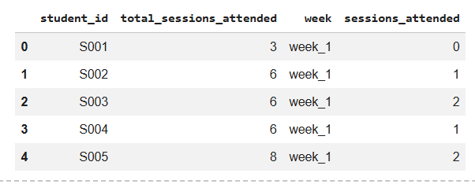
A Mini-Project: Student Success Data Wrangling Dashboard
Convert weekly attendance columns into rows.
attendance_long = attendance.melt(
id_vars=["student_id", "total_sessions_attended"],
var_name="week",
value_name="sessions_attended"
)
attendance_long.head()
Discussion:
This makes attendance easier to analyse week by week.

Slide 140
A Mini-Project: Student Success Data Wrangling Dashboard
Task 12: Stack and Unstack
Create a summary table of average final marks by campus and subject.
campus_subject = student_results.pivot_table(
index="campus",
columns="subject_code",
values="final_mark",
aggfunc="mean"
)
campus_subject

Slide 141
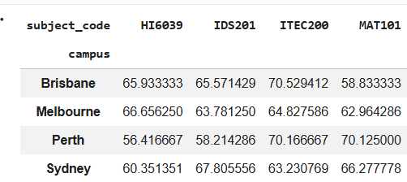
A Mini-Project: Student Success Data Wrangling Dashboard

Slide 142
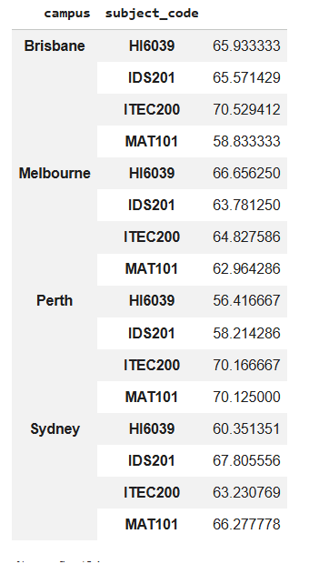
A Mini-Project: Student Success Data Wrangling Dashboard
Stack:
stacked = campus_subject.stack()
stacked

Slide 143
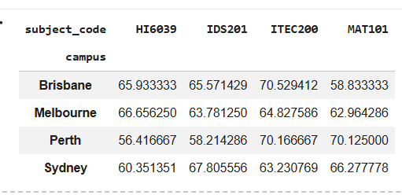
A Mini-Project: Student Success Data Wrangling Dashboard
Unstack:
unstacked = stacked.unstack()
unstacked

Slide 144
A Mini-Project: Student Success Data Wrangling Dashboard
stack() moves columns into rows. unstack() moves rows back into columns.

Slide 145
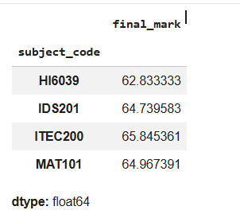
A Mini-Project: Student Success Data Wrangling Dashboard
Task 13: Mini Analysis
Average final mark by subject:
student_results.groupby("subject_code")["final_mark"].mean()

Slide 146
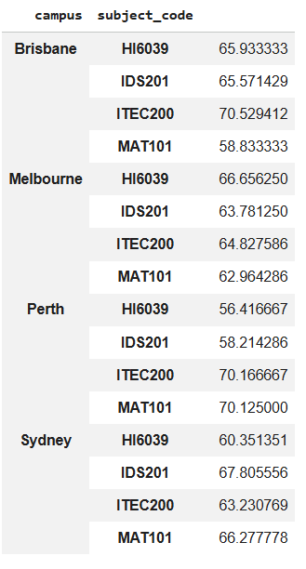
A Mini-Project: Student Success Data Wrangling Dashboard
Average final mark by campus and subject:
student_results.groupby(["campus", "subject_code"])["final_mark"].mean()

Slide 147
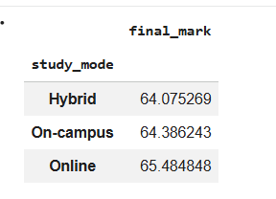
A Mini-Project: Student Success Data Wrangling Dashboard
Average final mark by study mode:
student_results.groupby("study_mode")["final_mark"].mean()

Slide 148
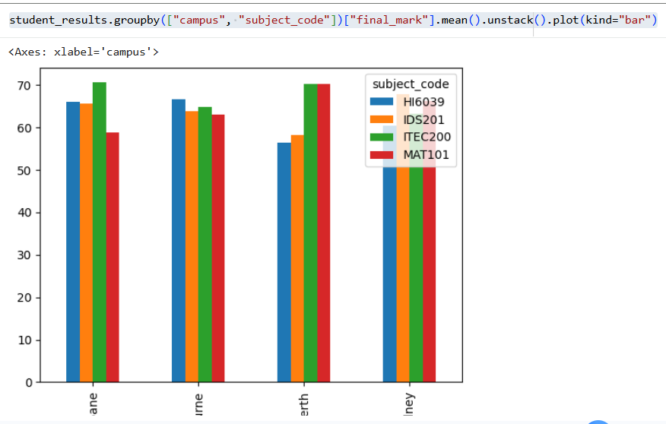
A Mini-Project: Student Success Data Wrangling Dashboard
Visualisation
student_results.groupby(["campus", "subject_code"])["final_mark"].mean().unstack().plot(kind="bar")

Slide 149

Let’s Answer Your Questions
Live during class – Ask directly during sessions.
Canvas Inbox – For structured academic queries.
Email – For formal communications or attachments.
Canvas Discussion Forum – Everyone can see and learn from your question.

Slide 150
Thank You
Have a Great Learning Day!
Feel free to reach out with any questions!

